Slide 1
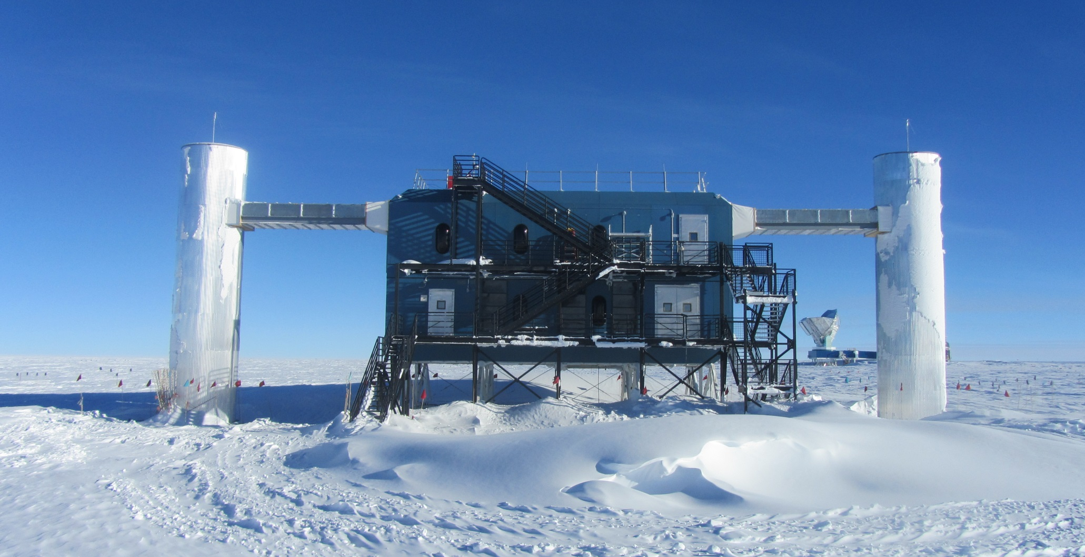

Title to describe research question, attract people to poster
Subtitle, if needed: general terms are more approachable
Authors names and affiliations, can include contact information
Introduction
Methods
Results
Conclusion
Subhead
A statement that gives a quick overview of your poster. Include relevant background to provide a context for understanding the central question or theme of your poster. Define acronyms if you use them, and avoid lab jargon.
Patie tat nim velessit iure core faccum enibh elisim eui tem zzrit, venisi ero esent praesenim ipsum quam, sim ilit autpatie molortie mod eum delit am, vulpute molenim incincil in henim vel ullam, quipisit ut aute modolummy nit acip exeraessed dolore eugait eugait, corer adiam dolore magniam consequip estin voluptat. Magnim do conse consenis dolestrud molorem et accummolor sequat non utet adipisl utpat, si.
Pat volorer si eui tat esequat aut nummy nulputpat volore tate volore modigna feuisci ncincipit wisit lore modigna feuismolore velit, sumsan hent vel iriustie dolore digna aliquat, vero.
Objectives/Goals/Problem
A concise statement of the goal, question, or problem. Include an hypothesis, if appropriate.
Volor ilit nonsendiate magna ad erciliquip eugiam velent alisl dolor auguerat. Ut dolore consendrerit verilla cons nosto cons nim quis elisci ex ea commy nis doloreet ex estie vent ad molesto diat.
Volor ilit nonsendiate magna ad erciliquip eugiam velent alisl dolor auguerat. Ut dolore consendrerit verilla cons nosto cons nim quis elisci ex ea commy nis doloreet ex estie ve.
Subhead
A brief description, diagram, or flow chart representing each key process or procedure used to test the hypothesis. This can also include a timeline of your work.
Patie tat nim velessit iure core faccum enibh elisim eui tem zzrit, venisi ero esent praesenim ipsum quam, sim ilit autpatie molortie mod eum delit am, vulpute molenim incincil in henim vel ullam, quipisit ut aute modolummy nit acip exeraessed dolore eugait eugait, corer adiam dolore magniam consequip estin voluptat. Magnim do conse consenis dolestrud molorem et accummolor sequat non utet adipisl utpat, si.
Pat volorer si eui tat esequat aut nummy nulputpat volore tate volore modigna feuisci ncincipit wisit lore modigna feuismolore velit, sumsan hent vel iriustie dolore digna aliquat, vero do odigna auguerit ing et nonse minci estrud tat ing et eugait in vel inismolum quisciliquis doluptatet praessi.
Nim augait, vel delessequat ad tatuero dui blan eu feuguer cillandre dolenisim dolor sequis nim ad min verit vulla at.
Subhead
Describe the data collected and the methods used to analyze the data. Photographs, tables, or graphs should be as large as possible, easily interpreted, and labeled with a caption or figure legend.
Er illaor se consequat. Duismolorer sis el inibh ea faccum ing eu feuis et aliquis nulluta tinibh ea facinis num exerat praesto od min ecte consequamet prat.
Patie tat nim velessit iure core faccum enibh elisim eui tem zzrit, venisi ero esent praesenim ipsum quam, sim ilit autpatie molortie mod eum delit am, vulpute molenim incincil in henim vel ullam, quipisit ut aute modolummy nit acip exeraessed dolore eugait eugait, corer adiam dolore magniam consequip estin voluptat. Magnim do conse consenis dolestrud molorem et accummolor sequat non utet adipisl utpat, si.
Pat volorer si eui tat esequat aut nummy nulputpat volore tate volore modigna feuisci ncincipit wisit lore modigna feuismolore velit, sumsan hent vel iriustie dolore digna aliquat, vero do odigna auguerit ing et nonse minci estrud tat ing et eugait in vel inismolum quisciliquis doluptatet praessi.
Subhead
Volor ilit nonsendiate magna ad erciliquip eugiam velent alisl dolor auguerat. Ut dolore consendrerit verilla cons nosto cons nim quis elisci ex ea commy nis doloreet ex estie vent ad molesto diat.
Volor ilit nonsendiate magna ad erciliquip eugiam velent alisl dolor auguerat. Ut dolore consendrerit verilla cons nosto cons nim quis elisci ex ea commy niS.
Subhead
Provide a summary; discuss significance of results, and key conclusions. Do the results support or not support the hypothesis?
Patie tat nim velessit iure core faccum enibh elisim eui tem zzrit, venisi ero esent praesenim ipsum quam, sim ilit autpatie molortie mod eum delit am, vulpute molenim incincil in henim vel ullam, quipisit ut aute modolummy nit acip exeraessed dolore eugait eugait, corer adiam dolore magniam consequip estin voluptat.
Subhead
Volor ilit nonsendiate magna ad erciliquip eugiam velent alisl dolor auguerat. Ut dolore consendrerit verilla cons nosto cons nim quis elisci ex ea commy nis doloreet ex estie vent ad molesto diat.
Volor ilit nonsendiate magna ad erciliquip eugiam velent alisl dolor auguerat. Ut dolore consendrerit verilla cons nosto cons nim quis elisci ex ea commy nis doloreet ex estie vent ad molesto dia.
Sample 1
Sample 2
Sample 3
References
Cite key publications in the text of your poster and list the references here. Include sources of any images if you didn’t include the information with the image.
1. Multimessenger Search for Sources of Gravitational Waves and High-Energy Neutrinos: Results for Initial LIGO-Virgo and IceCube The IceCube, LIGO and Virgo Collaborations: M. G. Aartsen et al; e-print archive arXiv:1407.1042 [astro-ph.HE], 3 July 2014
Chart caption
Acknowledgements
Dag Larsen/NSF
Thank the individuals, programs, and funding sources that contributed to the research.
Image caption example: The IceCube Laboratory at the Amundsen-Scott South Pole Station, in Antarctica, hosts the computers collecting raw data.

